Slide 1

Grade 4 Unit 4
Illustrated Glossary
Change Comes to New York

Slide 2
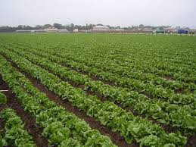
agriculture
www.pvwma.dst.ca.us
the science or occupation of cultivating the soil, producing crops, and raising livestock

Slide 3
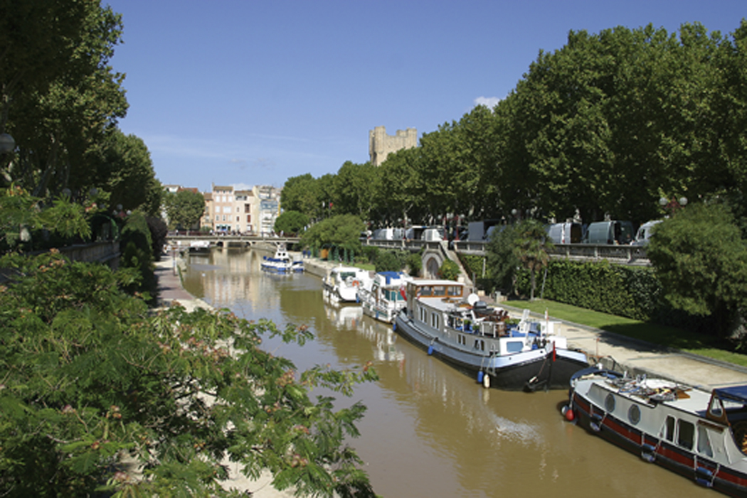
canal
a man made inland waterway built for transportation or irrigation

Slide 4
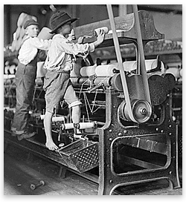
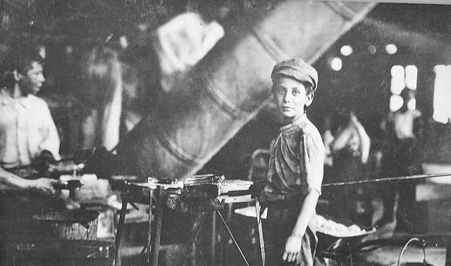
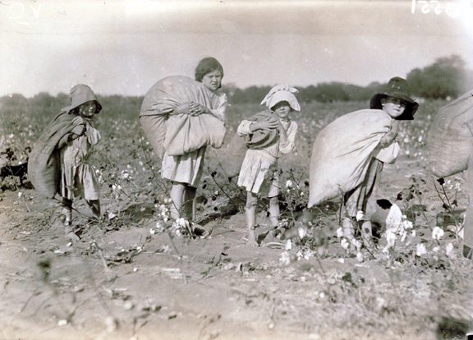
child labor
young children who worked in factories or mines beginning as young as 5 years old

Slide 5
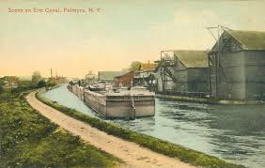
canal
www.eriecanal.org
an inland waterway built for transportation or irrigation

Slide 6
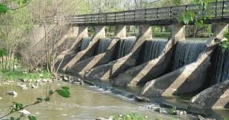
dam
www.hiking.ohiotrail.com
a barrier preventing the flow of water

Slide 7
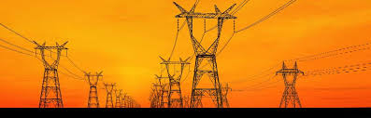
electricity
emp.lbl.gov
a form of energy that can be artificially produced

Slide 8
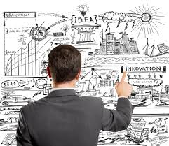
entrepreneur
www.james-caan.com
one who organizes, manages, and takes on the risks of a business

Slide 9
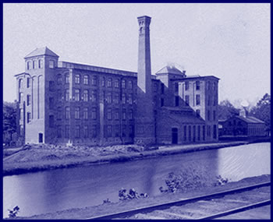
factory
a building or set of buildings equipped for manufacturing

Slide 10

finance
www.een-london.co.uk
the system that includes the circulation of money, the providing of banks and credit, and the making of investments

Slide 11
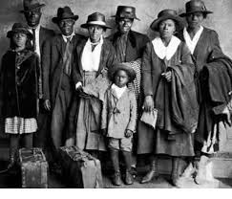
Great Migration
www.memorialhall.mass.edu
the movement of millions of African-Americans out of the South to the North, Midwest and West of the United States

Slide 12
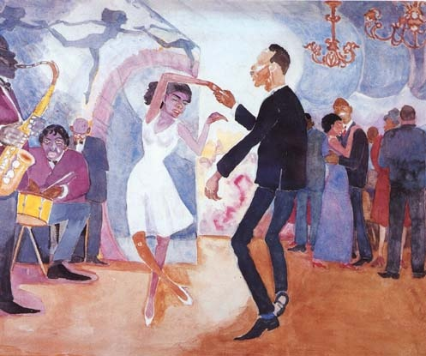
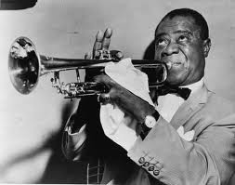

Harlem Renaissance
www.artlex.com
the new African-American cultural expressions that developed across the urban areas in the Northeast and Midwest United States

Slide 13
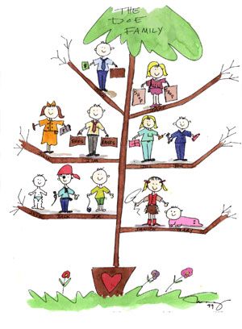
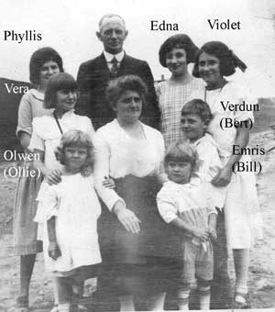
heritage
something acquired from the past

Slide 14
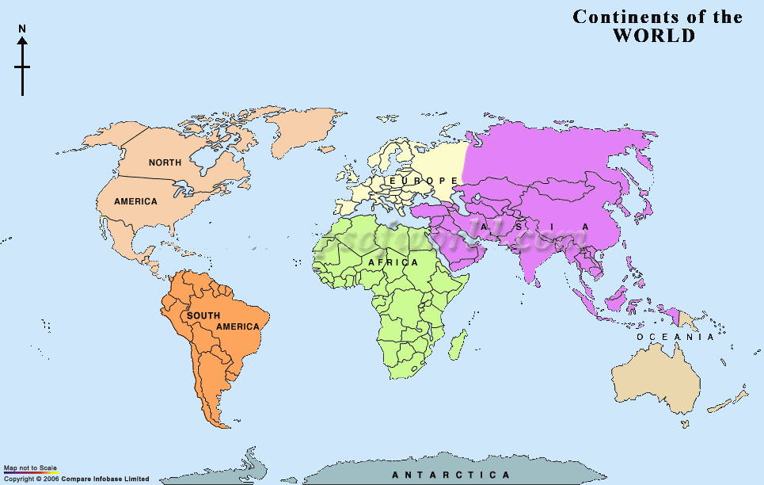
homeland
land where a person was born

Slide 15
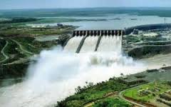
hydroelectric power
www.houghton-international.com
production of electricity by waterpower

Slide 16
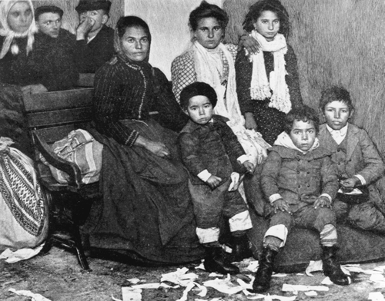
immigrant
a person who comes to a country to live there

Slide 17

inventor
www.futuristspeaker.com
a person who thinks up something new

Slide 18
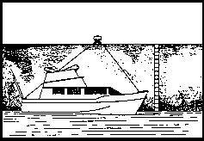
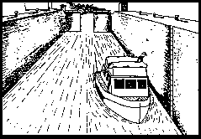
lock
http://www.eriecanal.org/locks.html
an enclosure in a canal, with watertight gates at each end. Used for raising or lowering boats from one level to another by filling or draining the water in the enclosure

Slide 19
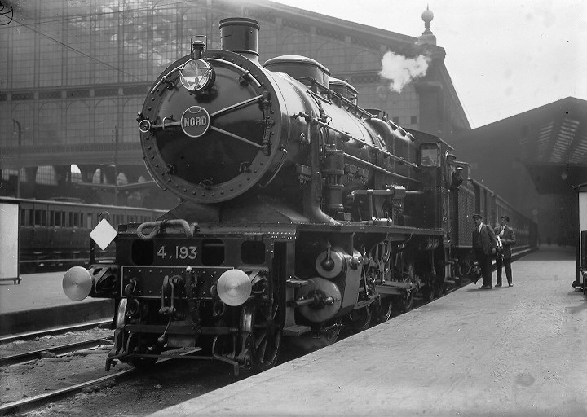
locomotive
a self-propelled engine, running on rails, used to move cars for passengers and freight

Slide 20
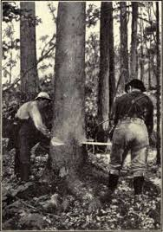
lumbering
chestofbooks.com
the business of cutting down trees for wood products

Slide 21
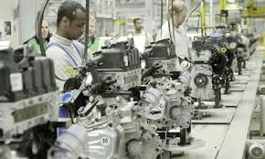
manufacturing
www.opeduca.eu
to make something from raw materials by hand or by machinery

Slide 22
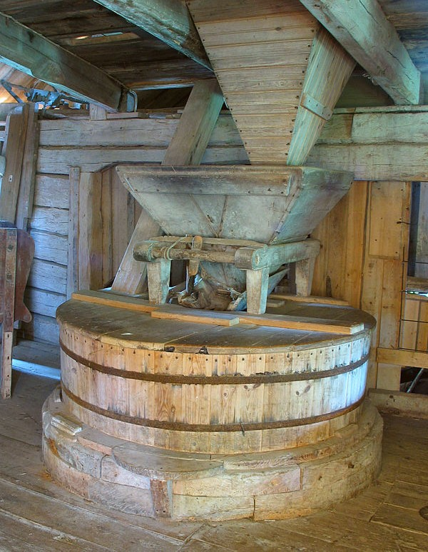
mill
en.wikipedia.org
a building with machinery for grinding grain into flour

Slide 23
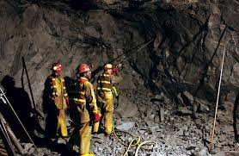
mining
www.miningiq.com
the process or business of removing ore or minerals (like coal or iron) from under the ground

Slide 24
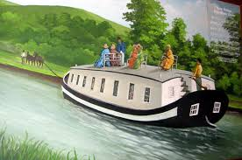
packet boat
www.flickr.com
a special boat designed to carry passengers instead of cargo

Slide 25
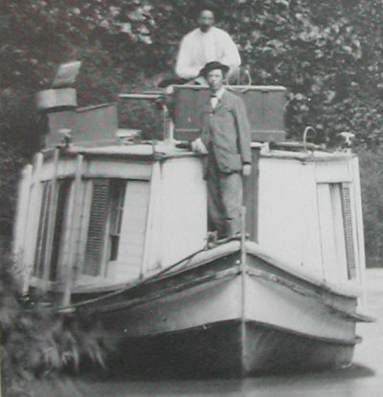
passage
a right to travel as a passenger on a boat

Slide 26
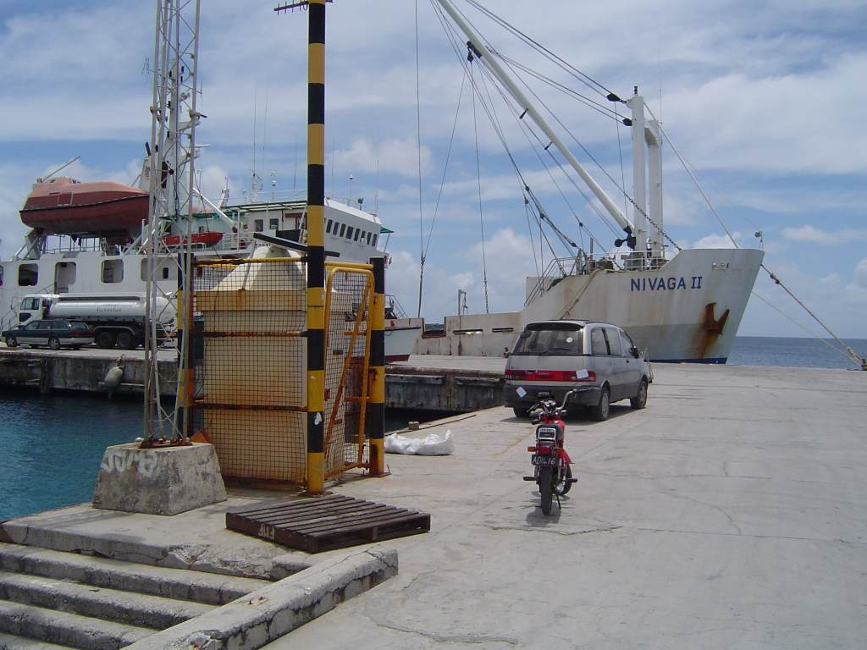
port
a harbor town or city where ships load or unload cargo

Slide 27
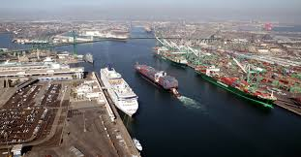
port
www.cubscoutpack788.org
a harbor town or city where ships load or unload cargo

Slide 28
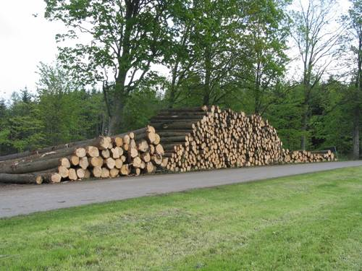
raw materials
natural or unprocessed minerals or plants from which useful products are manufactured

Slide 29
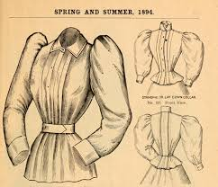
shirtwaist
vintageephemera.blogspot.com
a dress or blouse for women with details copied from men's shirts

Slide 30
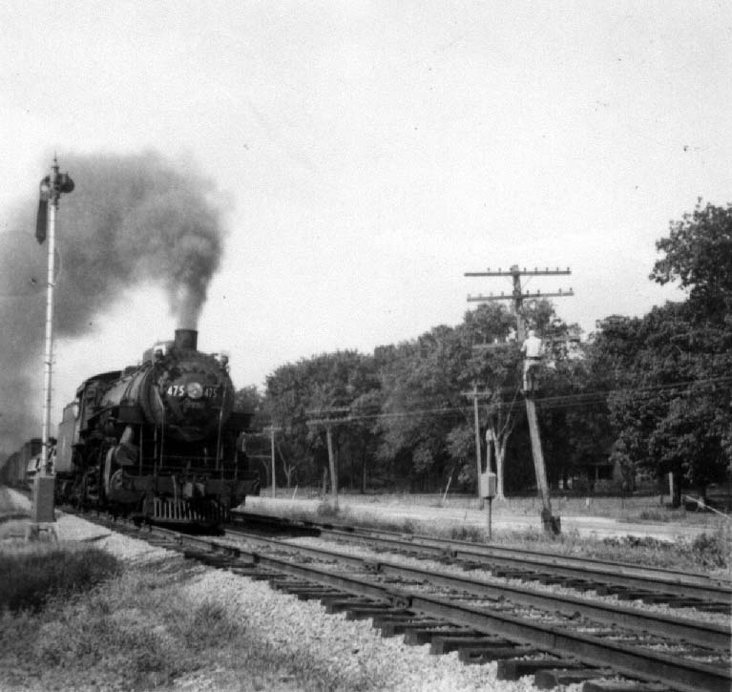
steam engine
an engine driven or worked by steam

Slide 31
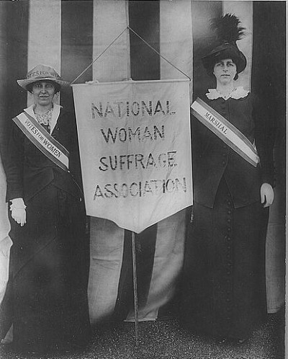
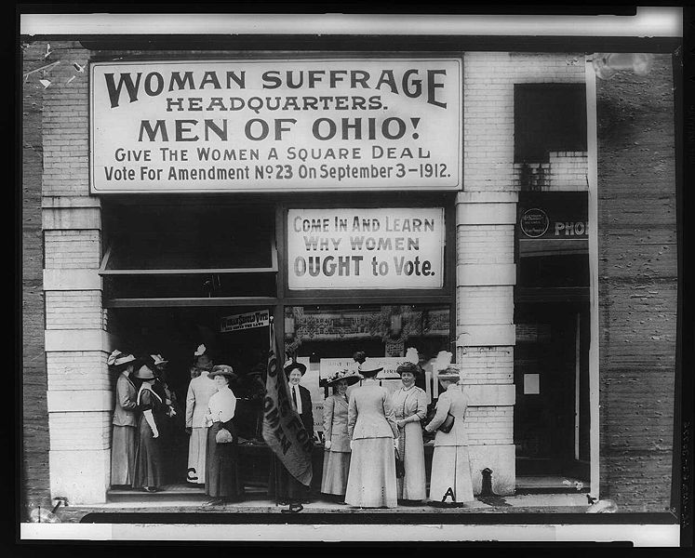
suffrage
the right to vote

Slide 32
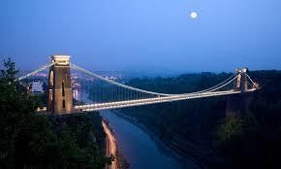
suspension bridge
www.walterdirks.com
a bridge that has its roadway suspended from two or more cables usually passing over towers and strongly anchored at the ends

Slide 33
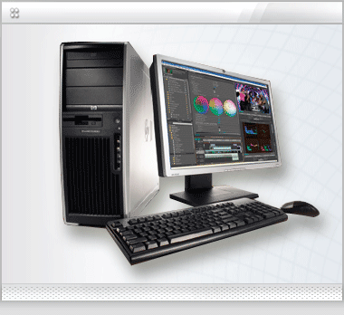
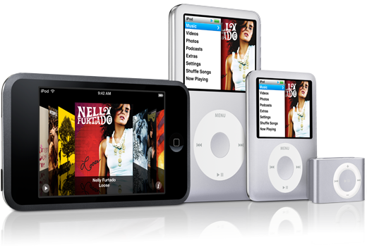
technology
the use of science in solving problems

Slide 34
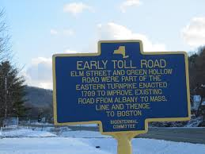
toll
rensselaerplateaulife.blogspot.com
a fee people pay to use a canal, bridge, or road

Slide 35
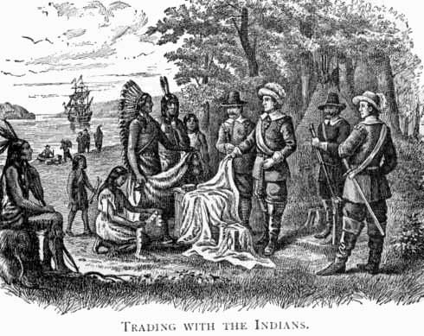
trade
the buying, selling, or exchange of goods

Slide 36
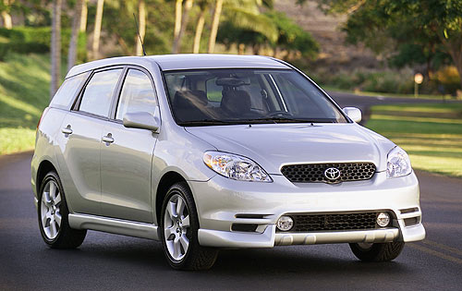
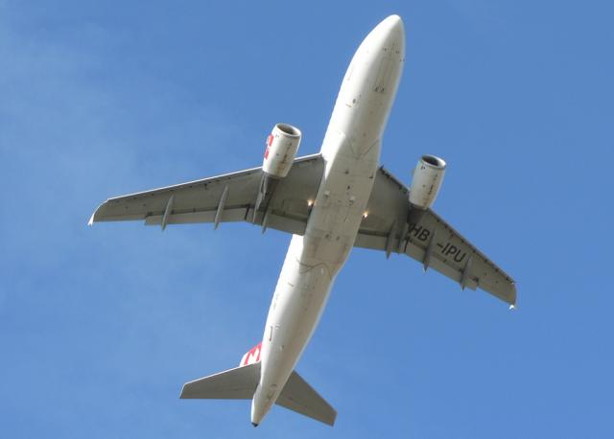
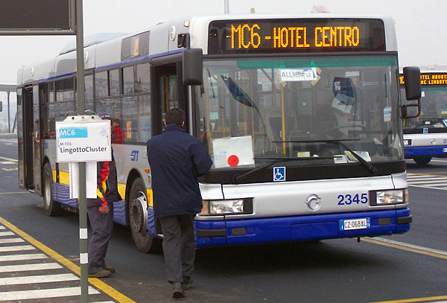
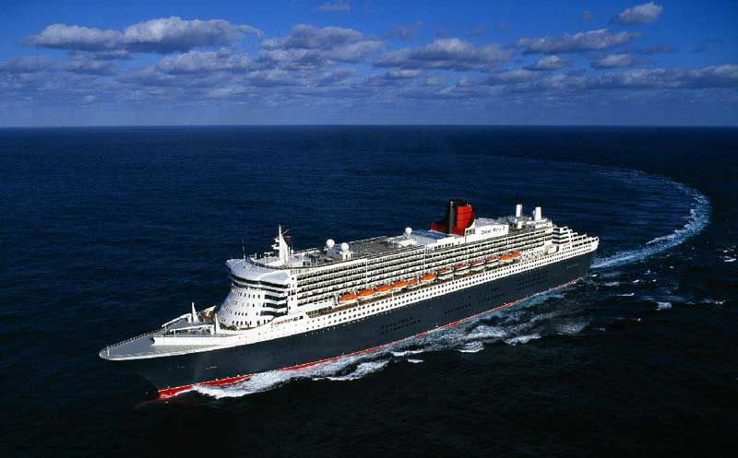
transportation
the moving of goods or people from one place to another

Slide 37
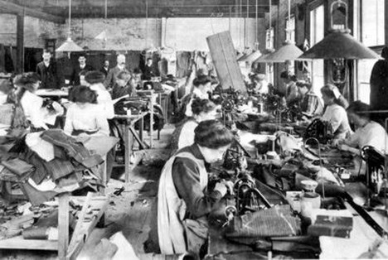
working conditions
low pay, long hours, and dangerous physical environment in the factories and mines for workers during the Industrial Revolution

